Slide 1

FOOD DELIVERY
Task - 1

Slide 2


FOOD DELIVERY
LMS Username | Name | Batch
2113a53223 | DEEPAK L | A53
2113a53241 | KISHORE C D | A53
2113a53215 | ARAVIND B | A53
2113a53217 | ARIVEZHILAN R.V.A | A53

Slide 3
This document outlines the requirements for a food delivery website. The website will
INTRODUCTION
enable users to order food from local restaurants and have it delivered to their homes. The
website will include a user-friendly interface, online payment options, and a delivery
system. The website will provide a smooth and efficient experience for ordering food online. This report will discuss the requirements needed to create the website, including user interface and functionality, payment systems, delivery systems, and additional features.

Slide 4

Task - 1
Creation of SRS & Github
Create SRS : “Your Project”
Creation & Set-up of Github account
Creation & Hands-on to various commands of Git Bash
Evaluation Metric:
100%Completion of the above tasks
Learning Outcome
Get to know about different lifecycle models.
Understanding importance and how to create an SRS
Knowing various commands of Github
Understanding agile and scrum management techniques for efficient product development

Slide 5
Step-Wise Description
User Interface and Functionality Requirements: This section will cover the user interface and functionality requirements of the website. This includes the design of the website, navigation, search, product display, ordering process, customer account creation and management, and other features.
Payment System Requirements: This section will discuss the payment system requirements of the website. This includes the payment gateway, payment options, security, and other related requirements.
Delivery System Requirements: This section will discuss the delivery system requirements of the website. This includes the delivery partners, delivery tracking, customer notifications, and other related requirements.
Additional Features Requirements: This section will discuss the additional features requirements of the website. This includes loyalty programs, discounts, promotions, customer support, and other related requirements.
Non-functional Requirements: This section will discuss the non-functional requirements of the website. This includes performance, scalability, security, usability, and other related requirements.
Constraints: This section will discuss any constraints that may affect the development of the website. This includes budget, timeline, system requirements, and other related constraints.

Slide 6
SUMMARY OF YOUR TASK:
This Software Requirements Specification (SRS) report outlines the requirements for a food delivery website. The report includes the purpose, scope, overall description, system requirements and design constraints for the website. The purpose of the website is to provide customers with an efficient, user-friendly ordering and delivery experience. The scope of the website includes user registration, order management, payment processing, delivery tracking, customer service and feedback. The overall description includes the user interface, functional requirements, and system integration requirements. The system requirements include the hardware, software, network and data requirements. The design constraints include security, scalability, maintainability and performance. The report also outlines the specific usability, reliability and supportability requirements.

Slide 7
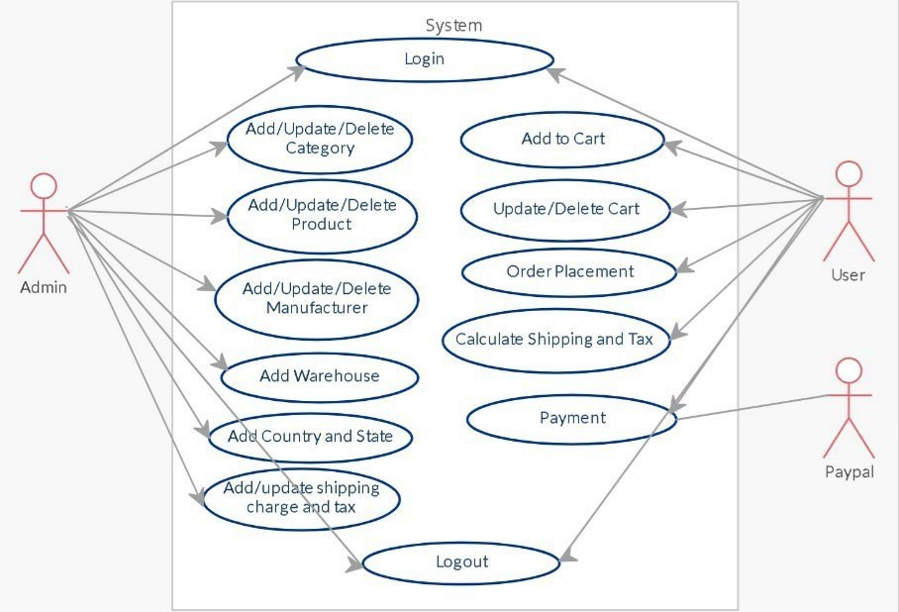
USE CASE DIAGRAM

Slide 8
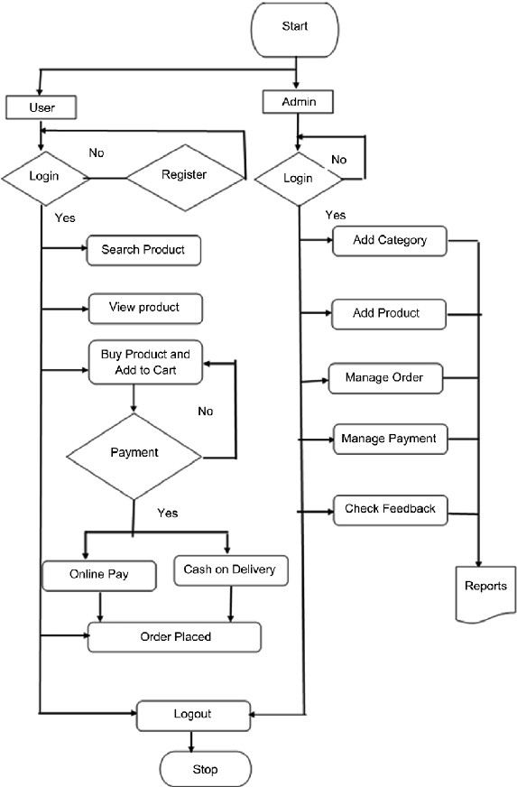
FLOW CHART

Slide 9
FUNCTIONAL REQUIREMENTS:
User Authentication: The system should support user authentication and authorization to ensure secure access to the system.
Shopping Cart: The system should allow customers to add, delete and modify items in their shopping cart.
Payment Gateway Integration: The system should provide integration with multiple payment gateways to accept payments from customers.
Product Catalog: The system should provide an extensive product catalog and search functionality for customers to browse and select items.
Order Management: The system should provide order management functionalities such as tracking, refunds, returns and cancellation of orders.
Inventory Management: The system should provide real-time inventory tracking and management capabilities.
Reports and Analytics: The system should provide reports and analytics to help merchants track and analyze sales, orders, customers and other key performance indicators.

Slide 10
NON FUNCTIONAL REQUIREMENTS
Performance: The website should be able to respond to all requests within a maximum of 5 seconds.
Availability: The website should be available 99.9% of the time with minimal downtime.
Scalability: The website should be able to accommodate an increase in user demand without any degradation in performance.
Security: The website should be secure and ensure data and transactions are encrypted.
Maintainability: The website should be easy to maintain and update as needed.
Usability: The website should be easy to use and navigate for all users.

Slide 11


Assessment Parameter
Gather requirements for the
project
add Readme.md file with description of the project
Prepare database design
schemas
Check-List
Commit all changes with "first commit"
Get your initial project
Structure ready
create a repository on github realted to project
Initiate a git repository
Push your changes to github

Slide 12


https://github.com/kishoreCD19/Group_A53_7
Submission Github

Slide 13


